Slide 1


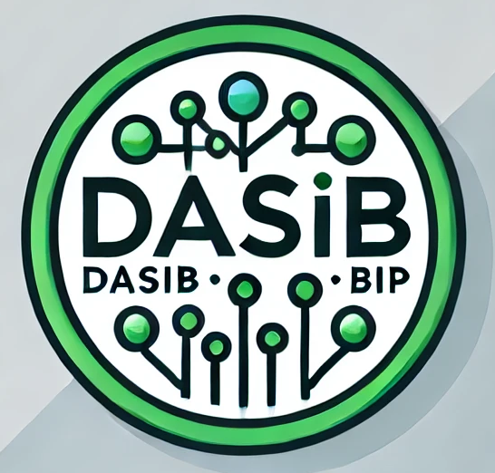




Program Objectives:
- Foundations of Data Science: Introduction to principles of statistical analysis, data mining, machine learning, and data visualisation techniques.
- Business Application: Learn how data science can address real-world business challenges.
- Practical Skill Development: Use tools and software like Python in hands-on projects.
- Cultural and Interdisciplinary Exchange: Collaborate with students from diverse backgrounds and fields.
- Critical Thinking and Problem Solving: Apply a structured and analytical approach to business challenges.
Program Structure:
Total Duration: 2 weeks
Week 1 (Online): Introduction to data science and analytics tools (Python and PowerBI).
Week 2 (On-site - Felgueiras, Portugal): Advanced applications in machine learning and a company visit to LIPOR.
Online Week: April 7-11, 2025
On-site Week: May 12-16, 2025
ECTS Credits and Funding:
Credits: 3 ECTS
Funding: Erasmus grants available to students from sending institutions. Additional support for sustainable travel options.
Partners:
University of Augsburg, Germany
Politehnica University of Timisoara, Romania
Polytechnic Institute of Porto - ESTG
Blended Intensive Program (BIP)
- Data Science for Business -
Hands-On Project: Students will work on projects addressing real challenges at LIPOR, such as analysing participation rates and performance in waste management systems.
For more information, please contact gri@estg.ipp.pt.

